Slide 1

Emerging Technologies
Session #09: Coding with Bluemix
IBM Bluemix
The Digital Innovation Platform
Sylvain-Roch WILBERT
s_wilbert@fr.ibm.com
Université Paris - Dauphine

Slide 2
Previously on….
We have seen how to use a local editor (ATOM) to code, and push the updates relying on
Cloud Foundry Command Line Interface
GIT
Our starting point
You have deployed using GIT in your workspace the 05-intechnicolor application

Slide 3
A definition
DevOps (a clipped compound of "development" and "operations") is a culture, movement or practice that emphasizes the collaboration and communication of both software developers and other information-technology (IT) professionals while automating the process of software delivery and infrastructure changes. It aims at establishing a culture and environment where building, testing, and releasing software, can happen rapidly, frequently, and more reliably (Wikipedia)

Slide 4
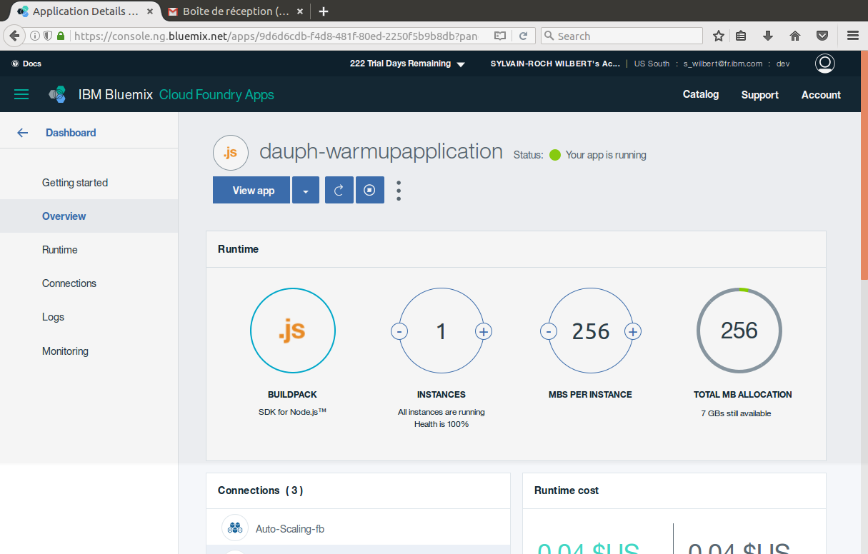
My application Let’s code

Slide 5
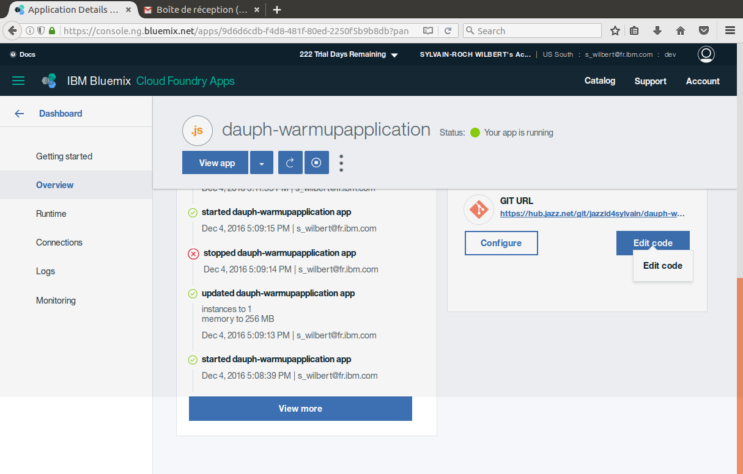

Slide 6
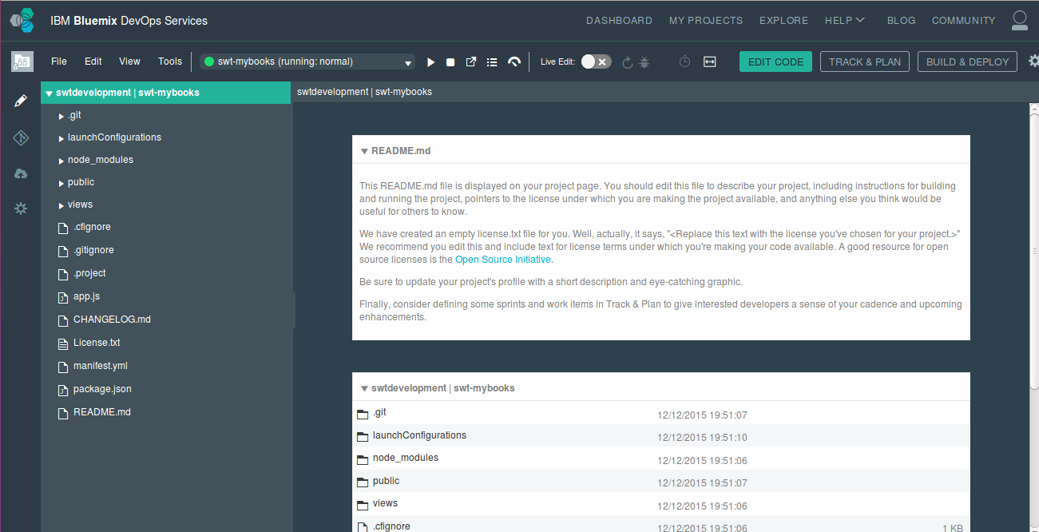
My application Let’s code
Access to the IDE
Access to the Git repo
BlueMix space configuration
Settings
The files as organised in local

Slide 7
My application Let’s code
Debug tool (Chrome browser)
Live edition (Direct update without any redeploy ex : Templates)
Back to Bluemix dashboard
Open the logs
Open the application
Stop the application
Deploy
Application Status
Additional tools: Fork project, Display shortcuts
Tweak editor appearance (Edirtor/Browser navigation)
IDE Tools: Search/Compare/Copy/Paste/Rename
Add/Import/Export files and folders to your project

Slide 8
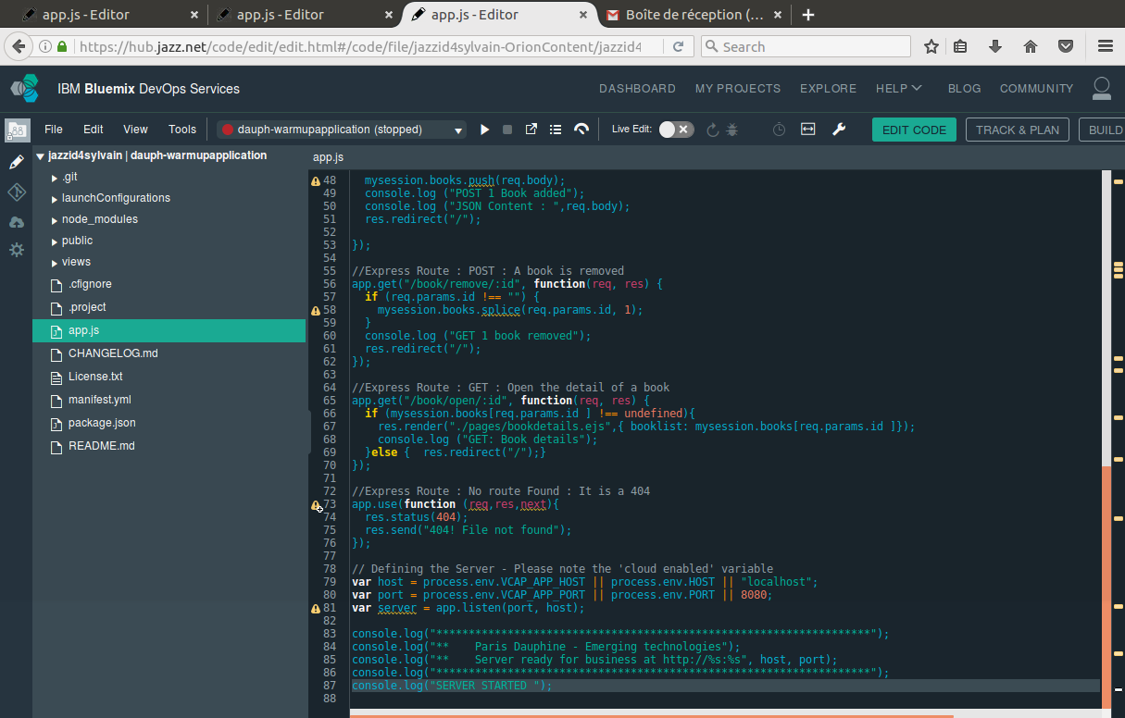
1
2
Live edit, can help to
- Edit templates without any restart
- Perform code without any redeploy

Slide 9
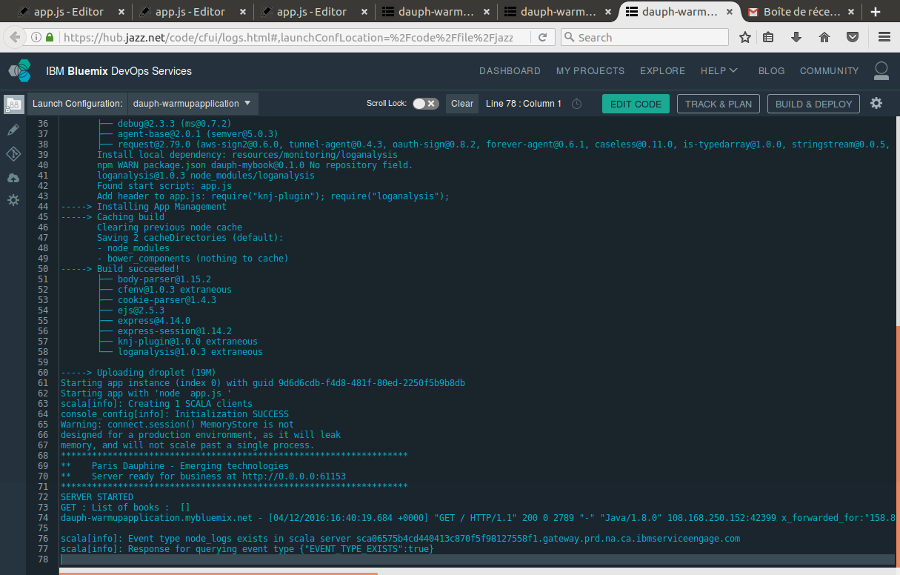

Slide 10
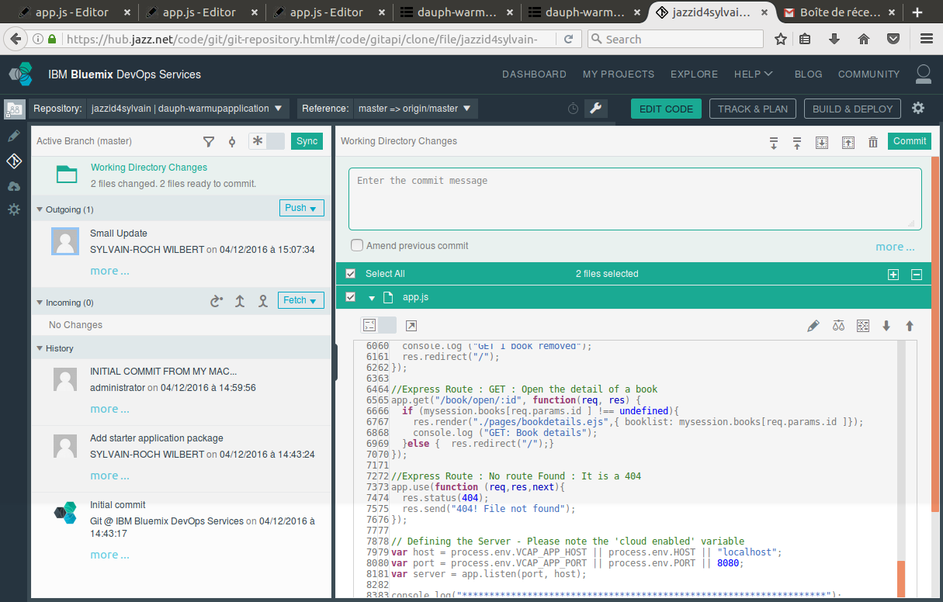

Slide 11
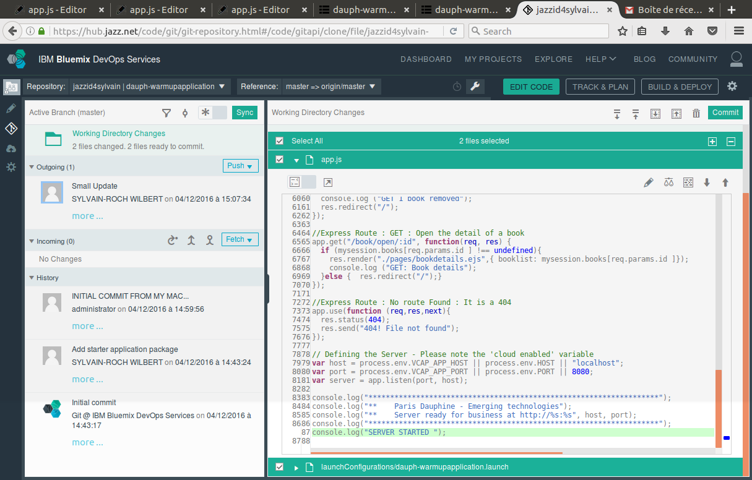

Slide 12
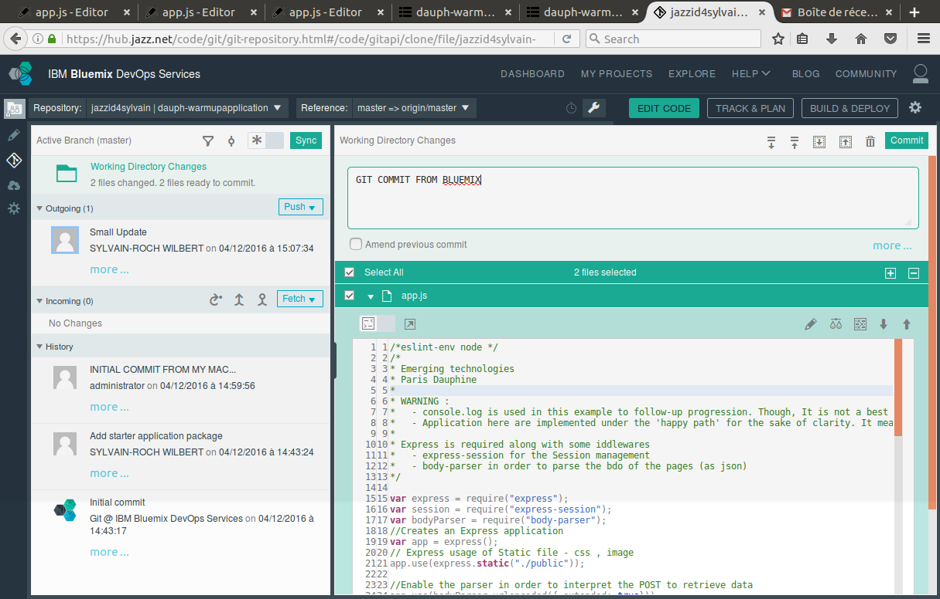

Slide 13
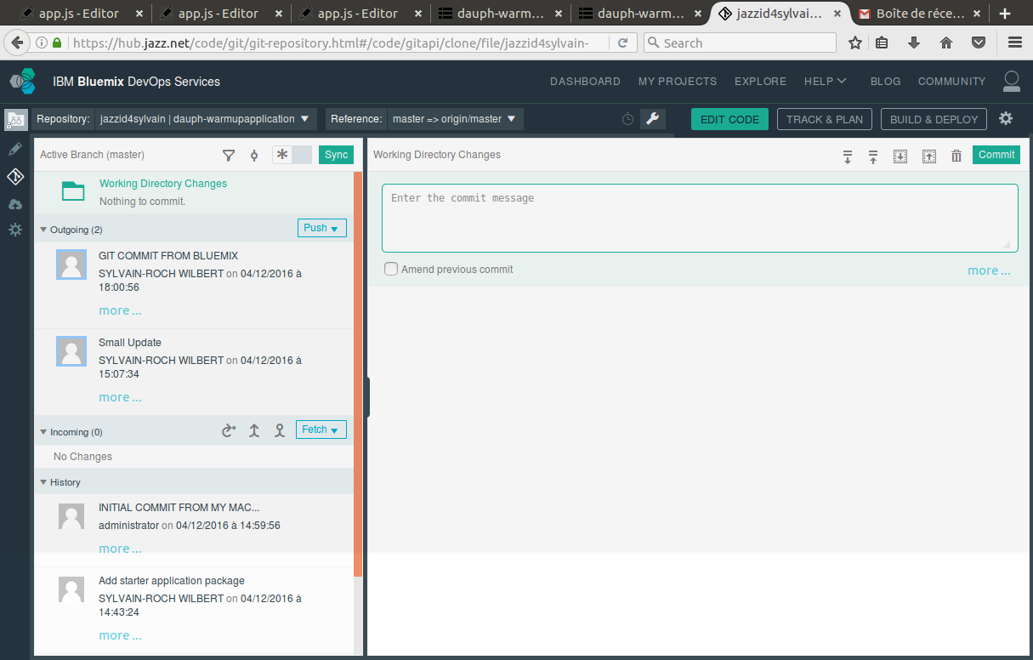

Slide 14
Exercize
Using the cloud Code editor, add a simple change to your code (template and/or code)
Deploy it locally
Review the change made (A template, and the app.js)
Select the ones to commit
Add a comment
Commit
Push
Validate the change

Slide 15
Coding Together, User A and User B
From his account, User A adds User B in his team as a developer for his dev space
User B logs on his Bluemix account and tries to edit the code from User A’s application
He needs to request a Git access from User A
User A grants the access
User B can
Edit the code (locally or in Bluemix)
Add, commit and push it to the repo
User A merges the code with the one received from User B on Bluemix

Slide 16
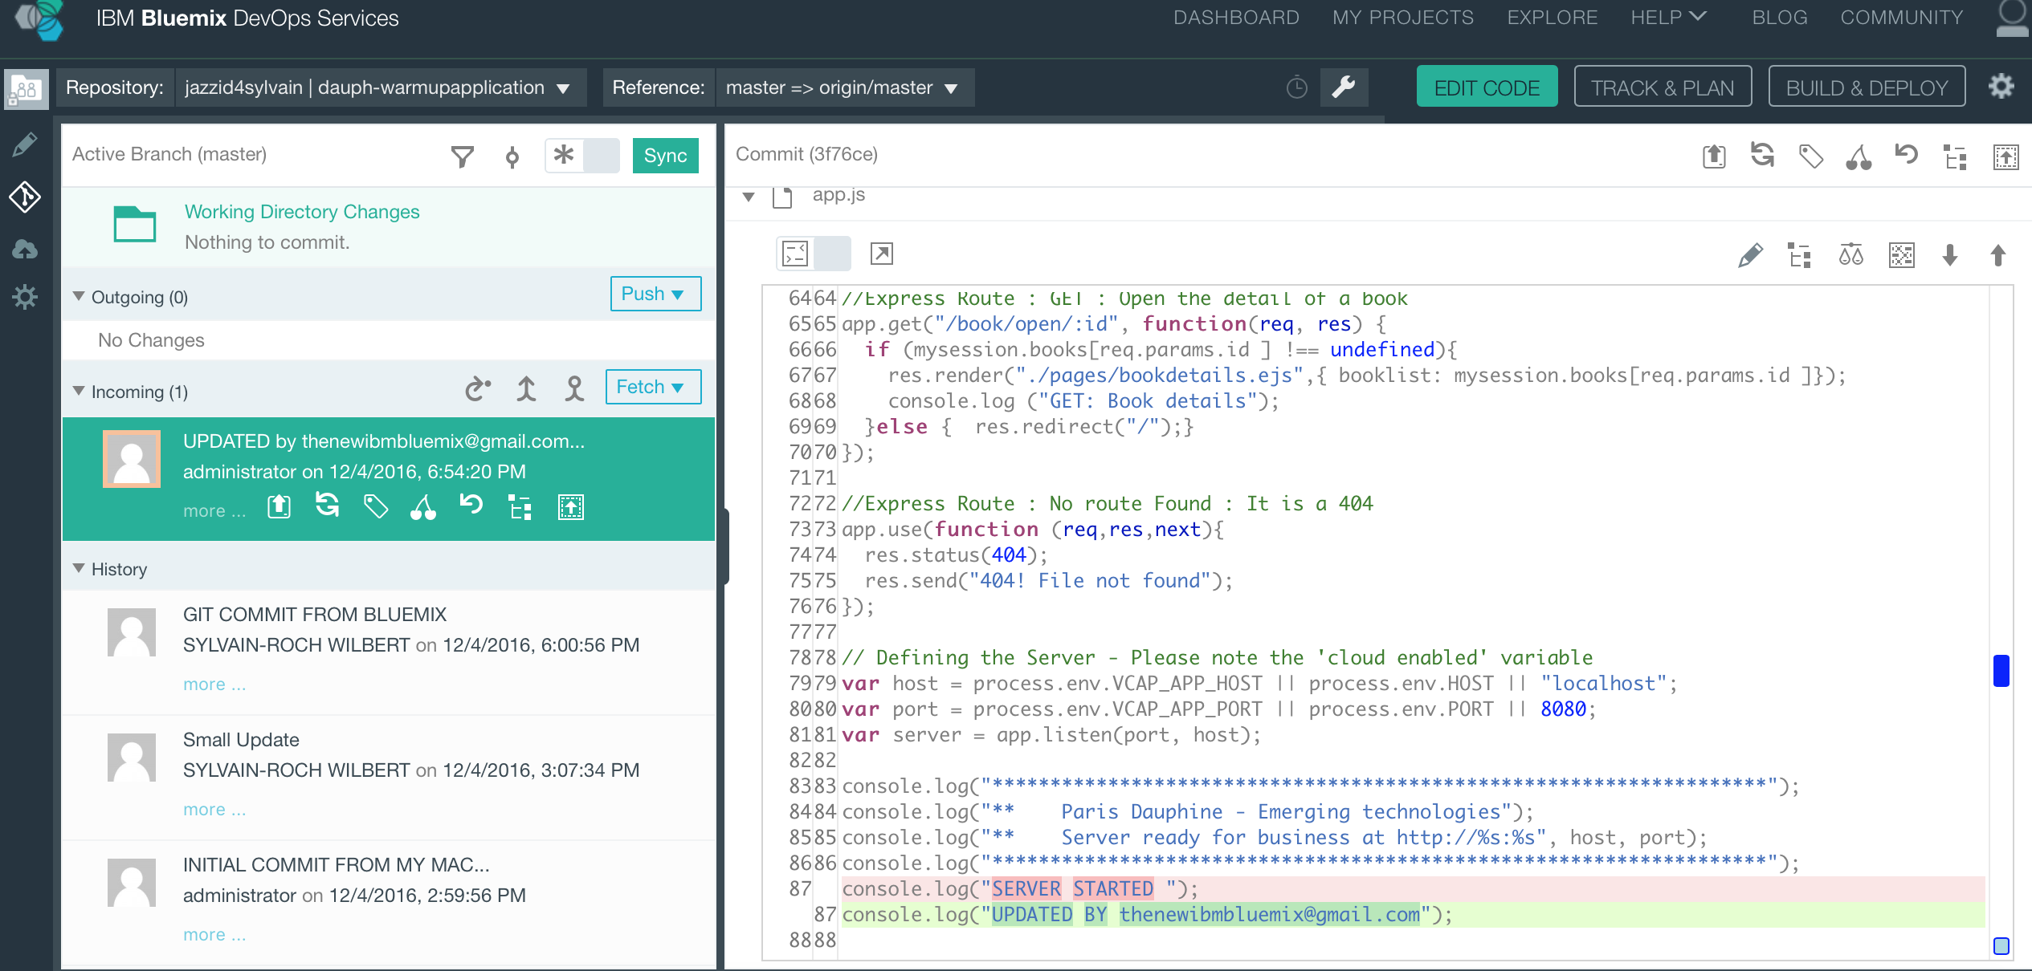
My application Let’s code together with GIT

Slide 17
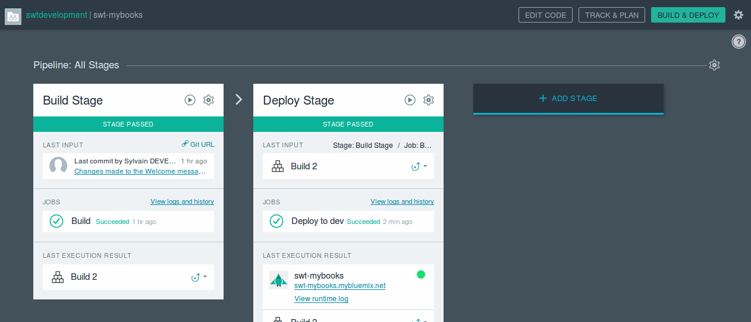
My application Build and Deploy (Optional)

Slide 18
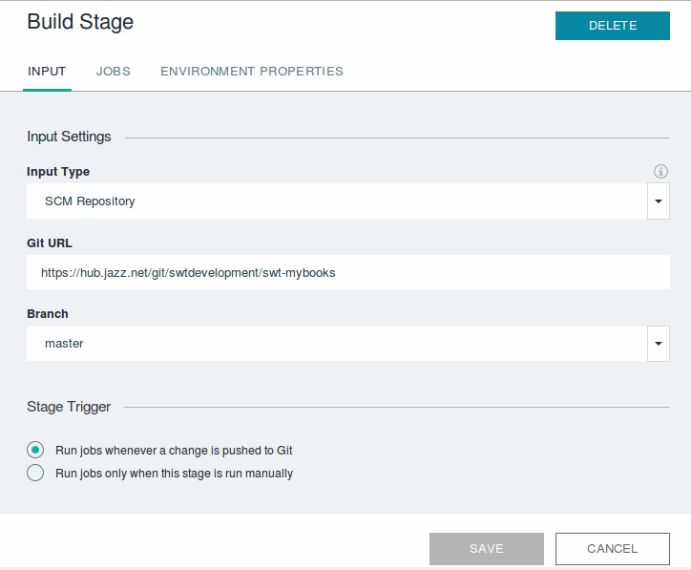
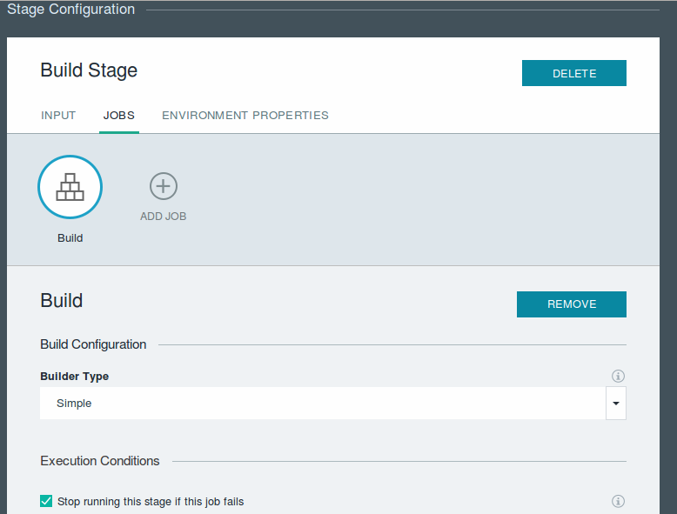
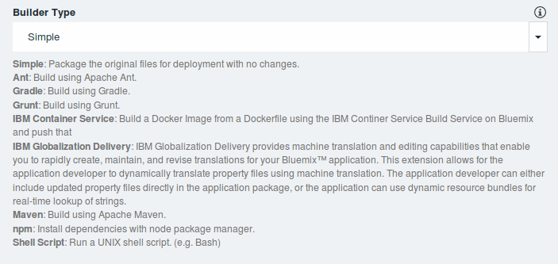
My application Build and Deploy (Optional)
Select the adapted triger to launch the Build (automatic launch)
Update the Build Job to perform if required

Slide 19
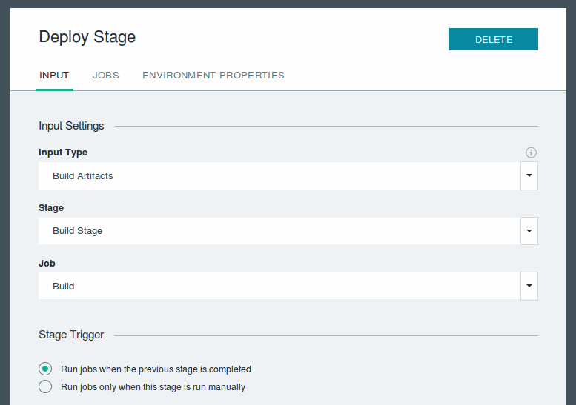
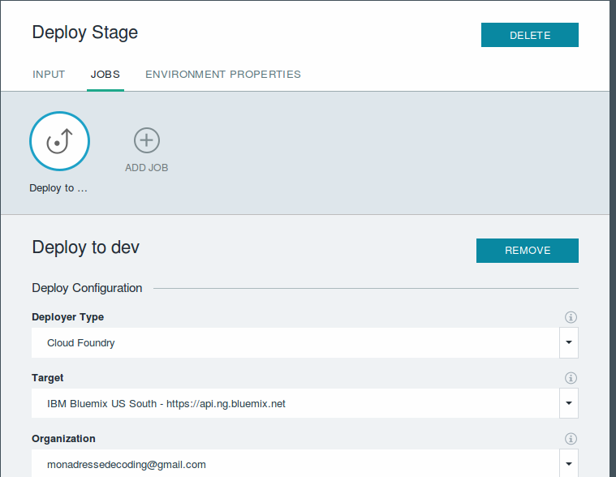
My application Build and Deploy (Optional)
Adjust the trigger if required
Adjust if required the deployment target

Slide 20
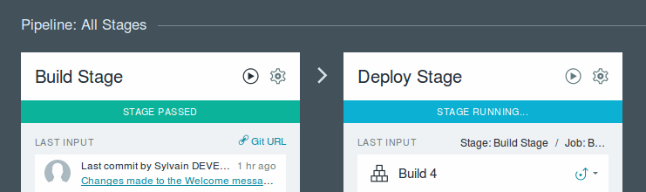
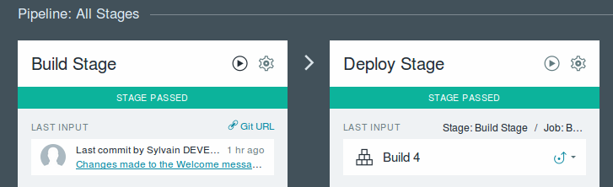
Exercize – My Application The Build and Deploy pipeline
Validate that the pipeline worked accordingly to you configuration (trigger, …)

